Slide 1
DIGITAL PORTFOLIO

Slide 2
DIGITAL PORTFOLIO
STUDENT NAME:KALEESHWARI B
REGISTER NUMBER &NM ID:2422K1575& asbru4q2422k1575
DEPARTMENT: COMPUTER SCIENCE
COLLEGE: K.S.G.COLLEGE OF ARTS AND SCIENCE
UNIVERSITY: BARTHIYAR UNIVERSITY

Slide 3
DIGITAL PORTFOLIO
USING FRONTEND DEVELOPMENT

Slide 4
AGENDA
Problem Statement
2. Project Overview
3. End Users
4. Tools & Technologies
5. Portfolio Design & Layout
6. Features & Functionality
7. Results & Screenshots
8. Conclusion
9. GitHub Link

Slide 5
PROBLEM STATEMENT
A problem statement is a clear and concise description of a problem or challenge that needs to be addressed. It typically includes: 1. Problem definition: A specific description of the problem. 2. Impact: The consequences or effects of the problem. 3. Goals: What you want to achieve in solving the problem.

Slide 6
PROJECT OVERVIEW
A project overview typically includes: 1. *Project goals*: What you aim to achieve. 2. *Target audience*: Who you’re creating for. 3. *Key features*: Main functionalities and components. 4. *Technical requirements*: Tools, technologies, and resources. 5. *Timeline*: Project schedule and milestones. 6. *Deliverables*: Expected outcomes and results. For your digital portfolio, the project overview might cover: - Showcasing skills and experience - Demonstrating expertise - Attracting potential employers or clients - Highlighting projects and achievements What specific aspects would you like to focus on in your project overview?

Slide 7
WHO ARE THE END USERS
1. Potential employers: Hiring managers, recruiters, or HR personnel looking for candidates with specific skills and experience. 2.Clients: Potential clients or customers interested in your services, skills, or expertise. 3. Industry peers: Colleagues, collaborators, or fellow professionals in your industry who want to learn from your experiences and projects. 4. Mentors or advisors: Professionals who can provide guidance, feedback, or mentorship. 5. Yourself: A personal reflection of your growth, progress, and achievements.

Slide 8
TOOLS AND TECHNIQUES
*Tools:* 1. Website builders (e.g., Wix, Squarespace, WordPress) 2. HTML/CSS/JavaScript frameworks (e.g., Bootstrap, React) 3. Design tools (e.g., Adobe XD, Figma, Sketch) 4. Content management systems (e.g., WordPress, Joomla) 5. Version control systems (e.g., Git, GitHub) *Techniques:* 1. Responsive web design 2. User experience (UX) design principles 3. Search engine optimization (SEO) 4. Content creation and curation 5. Image and multimedia opratioms

Slide 9
PORTFOLIO DESIGN AND LAYOUTS
*Key elements:* 1. *Clean and simple layout*: Easy to navigate and visually appealing. 2. *Consistent branding*: Use a consistent color scheme, typography, and visual identity. 3. *Clear typography*: Choose fonts that are legible and professional. 4. *Imagery and visuals*: Use high-quality images, graphics, or other visual elements to break up text and enhance the design. 5. *Whitespace*: Balance content with whitespace to create a clean and uncluttered design. *Layout ideas:* 1. *Grid-based layout*: Organize content into a grid structure for a clean and structured look. 2. *Hero section*: Use a prominent section to showcase your most important work or introduction. 3. *Project showcases*: Use cards, galleries, or sliders to display your projects. 4. *About section*: Include a brief bio, contact information, and relevant links. 5. *Call-to-actions*: Encourage visitors to explore more or get in to

Slide 10
FEATURES AND FUNCTIONALITY
Features: 1. Project showcase: A gallery or section to display your projects, with images, descriptions, and links to live demos or GitHub repositories. 2. About me: A brief bio or introduction to tell visitors about your background, skills, and interests. 3. Skills and expertise: A section highlighting your technical skills, certifications, or areas of expertise. 4. Contact information: A way for visitors to get in touch with you, such as a contact form, email address, or social media links. 5. *Blog or articles*: A section for sharing your thoughts on industry trends, tutorials, or experiences. *Functionality: 1. *Responsive design*: Ensure your portfolio is accessible and looks great on various devices and screen sizes. 2. *Easy navigation*: Organize your content in a logical and intuitive way, making it easy for visitors to find what they’re looking for. 3. *Interactive elements*: Consider adding interactive features like animations, scrolling effects, or hover effects to enhance user experience. 4. *SEO optimization*: Optimize your portfolio for search engines to improve visibility and attract potential employers or clients. 5. *Regular updates*: Regularly update your portfolio with new projects, skills, or experiences to demonstrate your growth and progress.

Slide 11
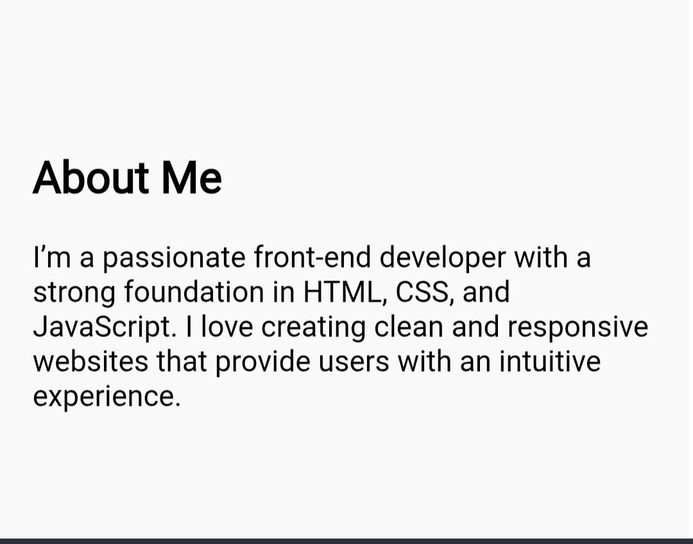
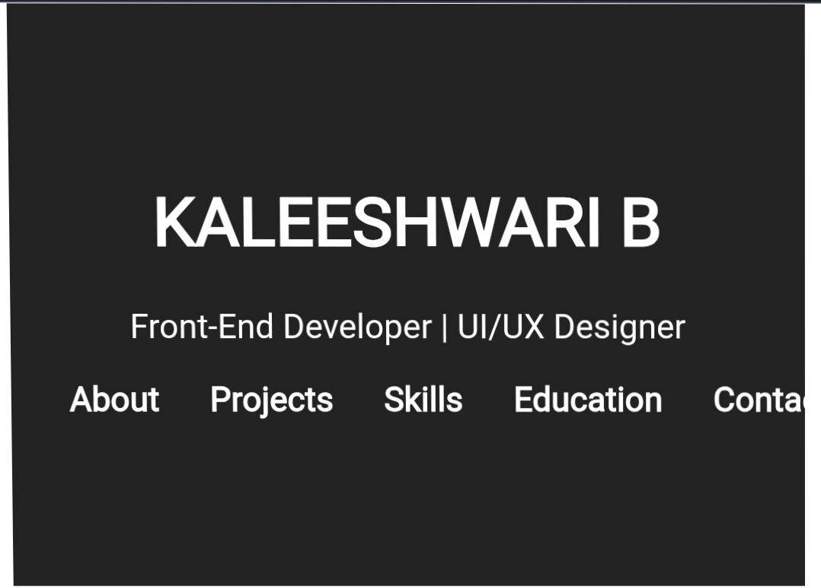
RESULTS AND SCREENSHOTS

Slide 12
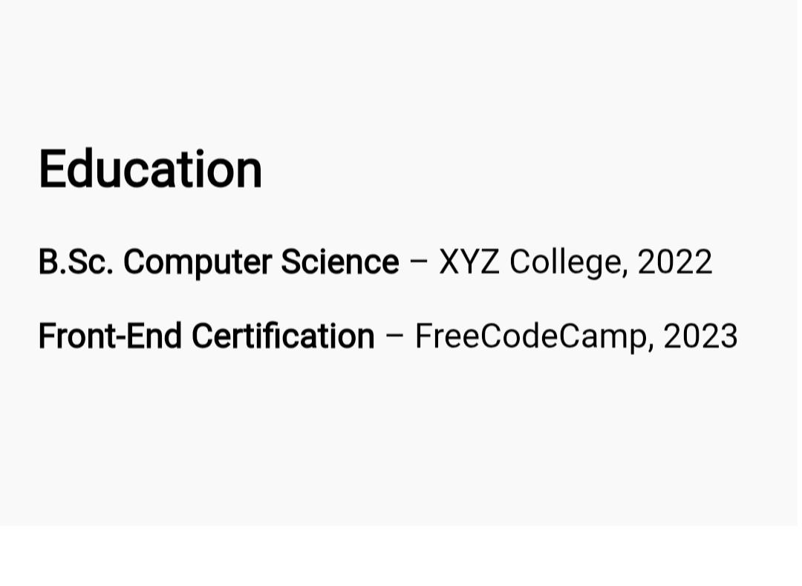
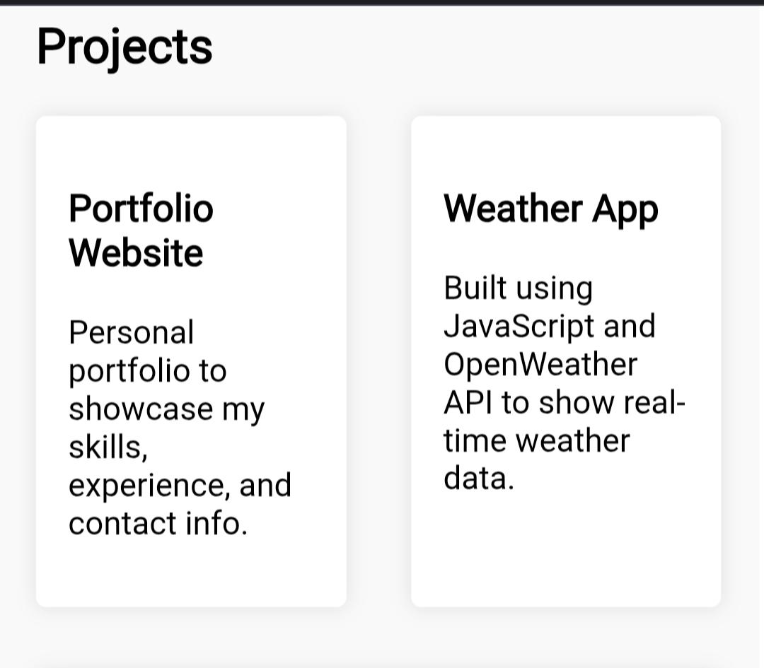
SCREENSHOTS

Slide 13
CONCLUSION
1. Define your goals: Identify your target audience and what you want to achieve with your portfolio. 2. Showcase your best work: Curate a selection of projects that demonstrate your skills and accomplishments. 3. Make it easy to navigate: Use a clear and intuitive design to help visitors find what they’re looking for. 4. Keep it up-to-date: Regularly update your portfolio with new projects and experience

